Slide 1
60 Day Assessments
“OACCD initiative – Completing Needs Assessments within 60 days from admission,
Analysis to Implementation”

Slide 2
Objective
Assessments within 60 days of New Admissions
OAR - Risk Assessments https://oregon.public.law/rules/oar_291-078-0020
OAR – Case Planning https://oregon.public.law/rules/oar_291-078-0026
Notes:
At

Slide 3
Administrative Analysis
Josephine County prioritized the completion of a needs assessment and case plan on new cases within 60 days from admission, (February 4th, 2022)
LSCMI & WRNA averaged about 75 days for completion, at that time
Began with a timeline analysis, tracked 15-20 cases from sentencing to LSCMI completion
Several points of consistent delay were identified
Notes:
At

Slide 4
Administrative Analysis
Group intake was being scheduled out 14-21 days on average
PO’s had “intake appointments” but time wasn’t protected, PO’s were often “re-scheduling” the LSCMI for 2-3 weeks out.
Philosophical adjustment was needed regarding rapport building.
Notes:
At

Slide 5
Staff Analysis
A Case Management Training was developed to facilitate a staff analysis on 2/9/22
Lesson Plan was followed to guide the staff analysis with an emphasis on the following
Communicate objective
Answer the Question – WHY?
Office visit Progression
What is working?
Barriers
Strategies
Notes:
At

Slide 6
Results of Staff Analysis
Findings and strategies from staff analysis were summarized and emailed to staff:
Established Standards and Objectives
What is working for us now
Current & Potential Barriers
Solutions
Action Steps
Notes:
At

Slide 7
Operational Considerations
Increase number of group intake days per week.
Kept the number of intake groups the same but increase the volume of participants by adding an additional certified staff member and a case specialist (for administrative efficiency).
See Office Visit Progression
Notes:
At

Slide 8
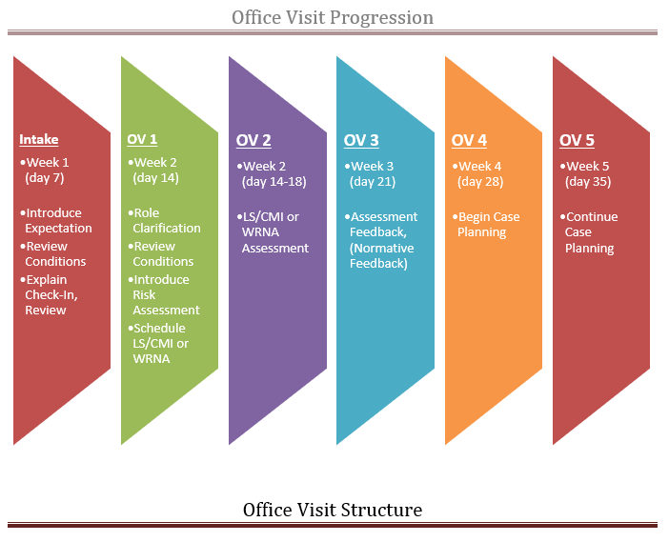
Notes:
At

Slide 9
Ongoing Analysis
Use OMS to track assessments – (New, Overdue, Completed)
Group intake list* with status. Weekly follow up by Lead PO
Quarterly caseload reviews* prepared by Lead PO with Supervisor oversight
DOC statewide, 60 day, LSCMI / WRNA emails
Operational
Not Done/Pending
Dashboards* provided on OACCD website
“Assessments within 60 Days of New Admission”
Notes:
At

Slide 11
Considerations for Implementation
Jurisdictionally relevant solutions – not a one size fits all intervention
Philosophy of assessment application
Consistent monitoring until fundamental tasks are re-prioritized.
Push back – considerable amounts coming.
Notes:
At

Slide 12
Future Considerations
Case planning
Notes:
At

