Slide 1

VISOR Demo
9/2023
Victim Information System in Oregon

Slide 2


Introductions
Saydyie DeRosia
Victim Services Program Coordinator
Oregon Department of Corrections
Parrish Van Wert
Policy & Business Services Administrator
Oregon Department of Corrections
saydyie.l.derosia@doc.oregon.gov
503-302-5388
parrish.l.vanwert@doc.oregon.gov
503-569-5347

Slide 3

Introducing Oregon's Enhanced Victim Information System (VISOR)
Welcome to Oregon's Innovative System
Business Model Transformation: ODOC-owned Data
Real Time Notifications
Enhanced Features for Victims & Partners

Slide 4
Advantages of the new system
Intuitive victim portal for simplified registration and alerts.
Immediate, secure AIC movement updates.
Maintenance made easy with no county hardware.
Unified jail accounts for streamlined communication.
Broad AIC data coverage from diverse sources.(ODOC, OYA, County Jails, Community Corrections, and Board of Parole)
Victim support available via email & phone for portal and related inquiries.

Slide 5
How does VISOR work?
Booking Occurs
VISOR data gets updated
User Registers
Custody Status Updates
User Gets Notification

Slide 6

Victim Notification Types
30 days prior to release
Release
Death
Transfer
Escape
Hearings
Emergency notices

Slide 7
Notification Methods
Anonymous Registration
Customizable notifications
choose how *SMS, email, phone) what, when, and how you receive them.
Option to set blackout dates
pause notifications on sensitive dates (anniversaries, birthdays, holidays, etc.)

Slide 8
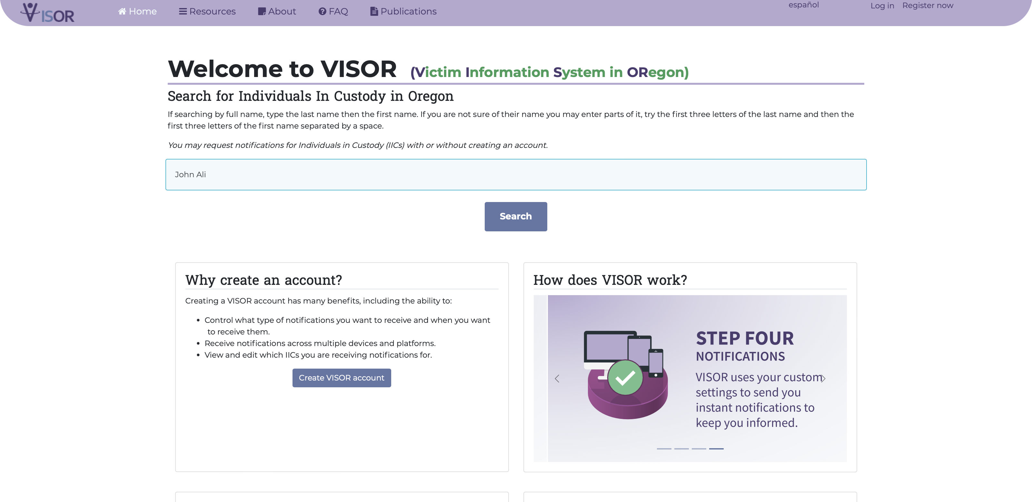
Search for a Individual in Custody as an anonymous user

Slide 9
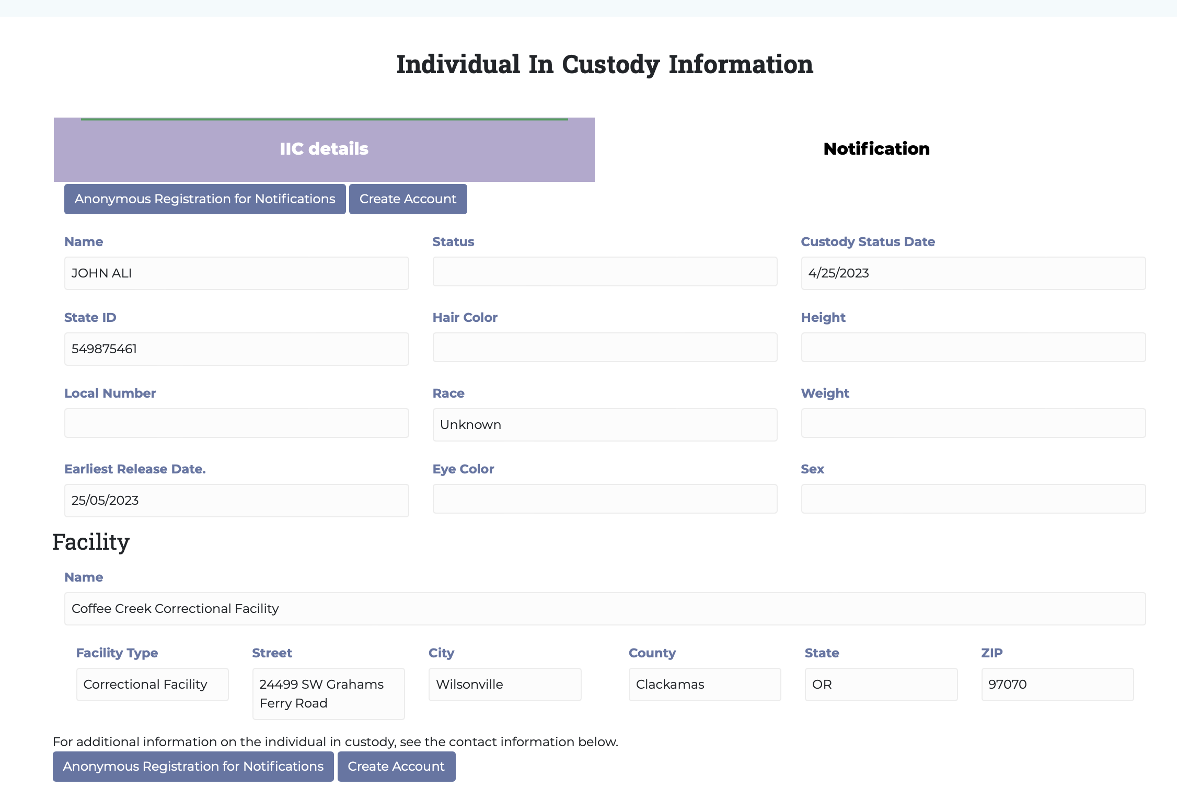
View IIC custody status

Slide 10
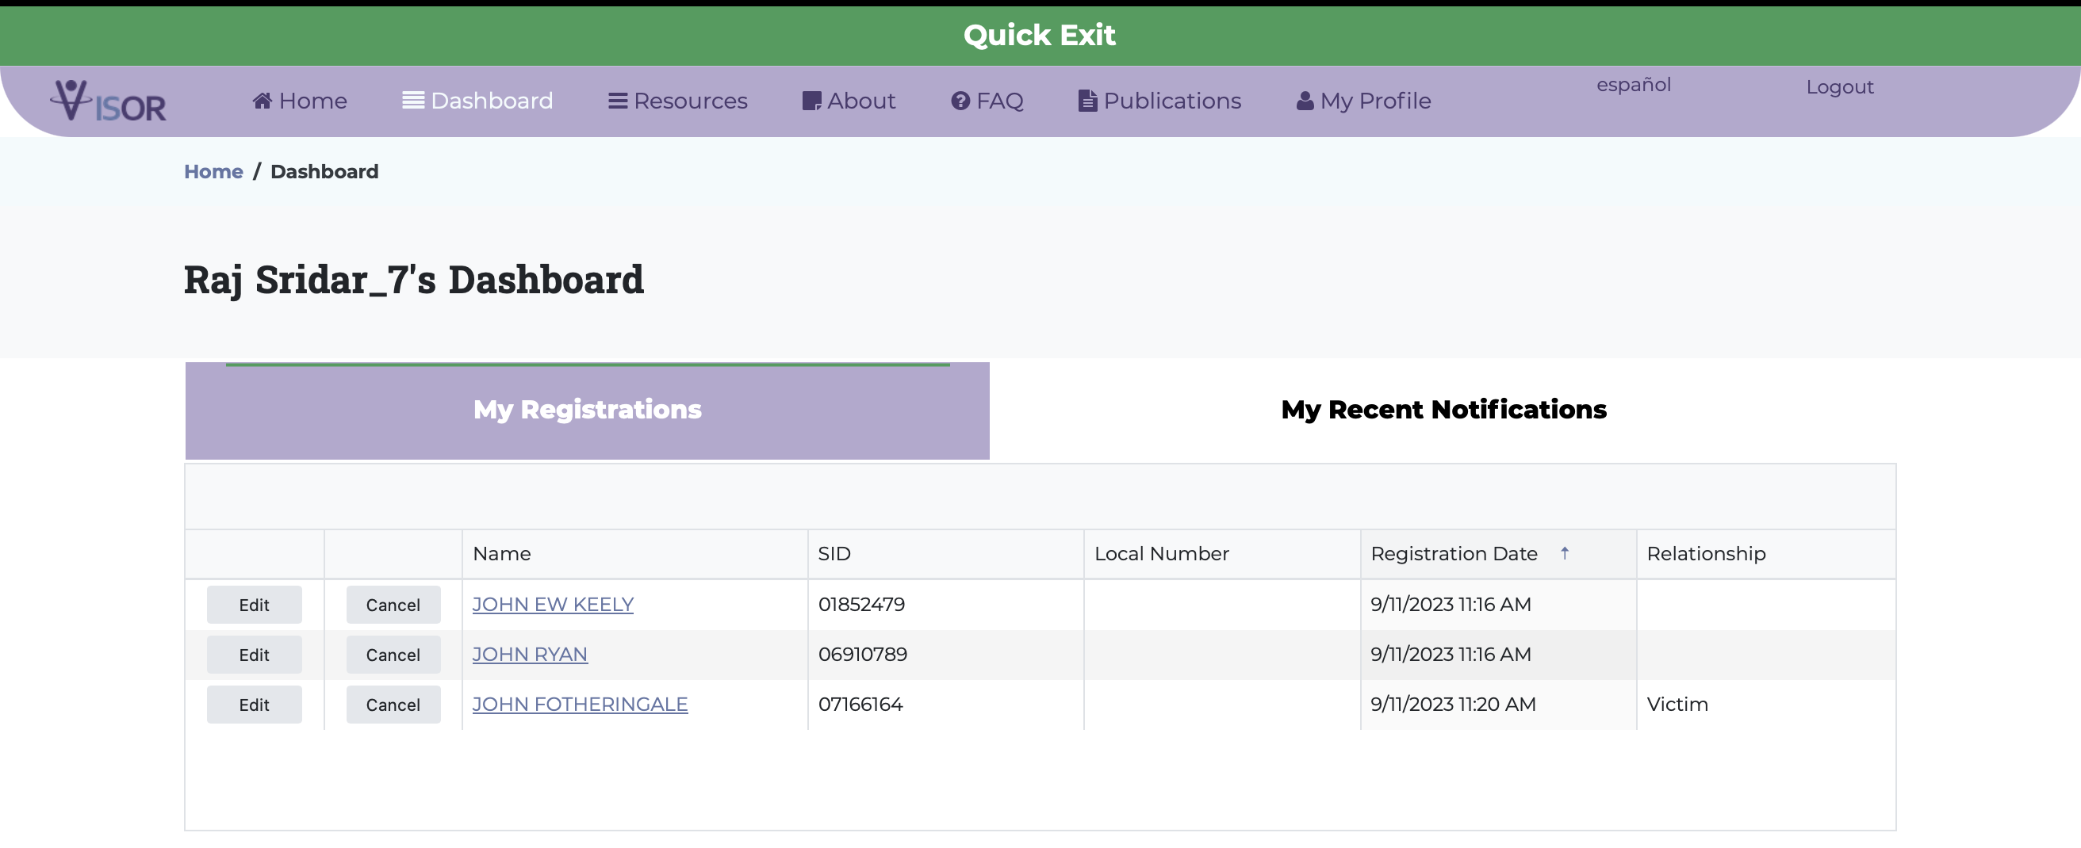
Register to receive customized notifications

Slide 11
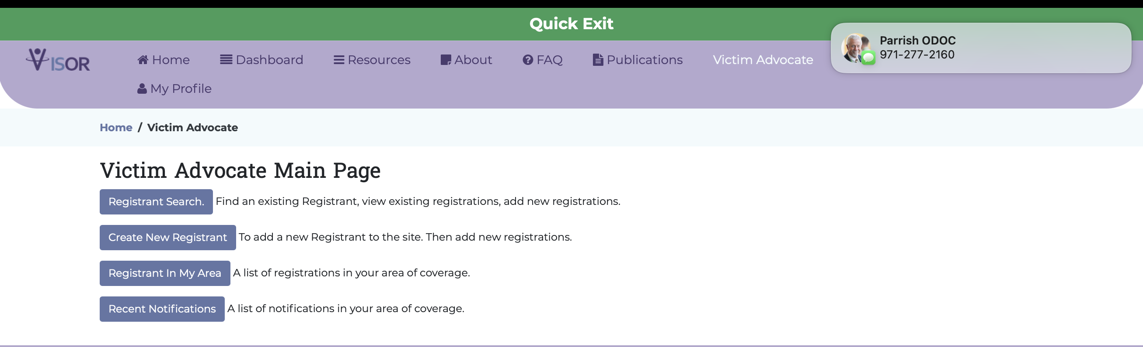
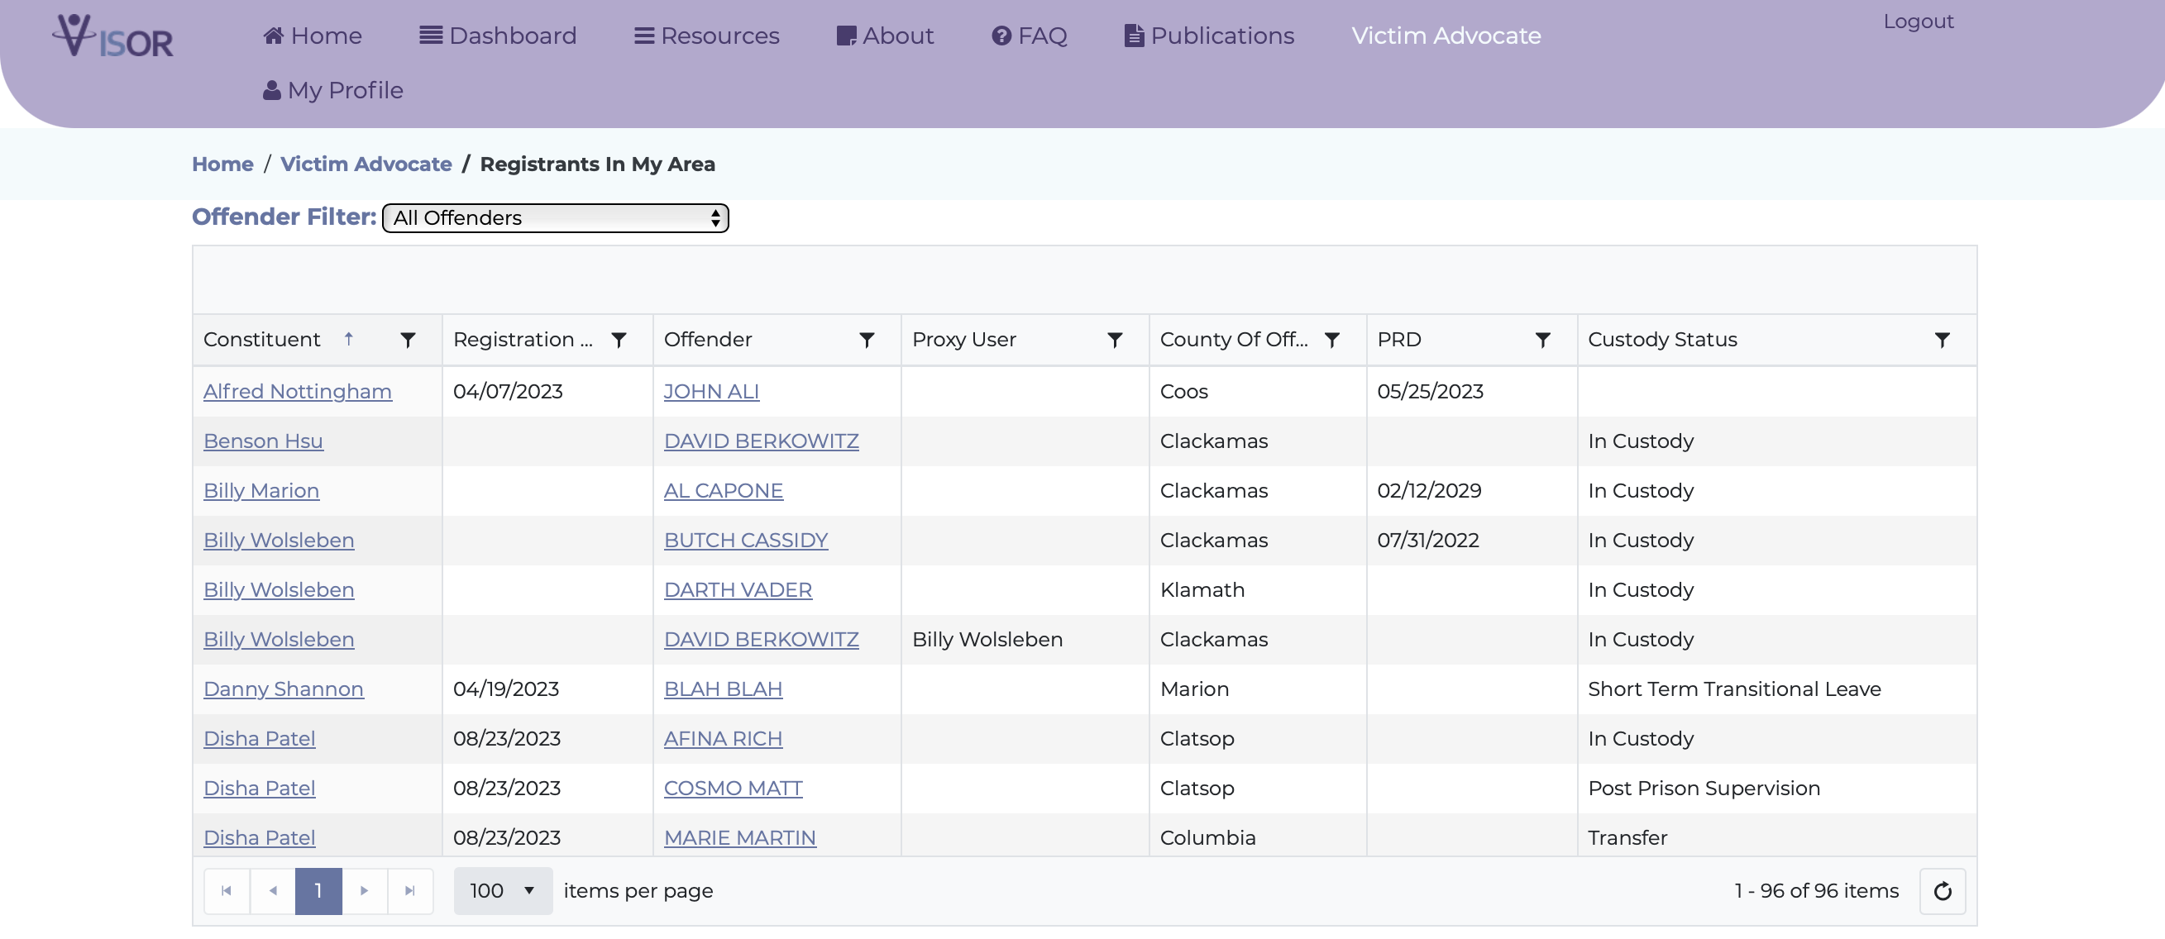
Ability to view & support registrants as a Victim Advocate

Slide 12
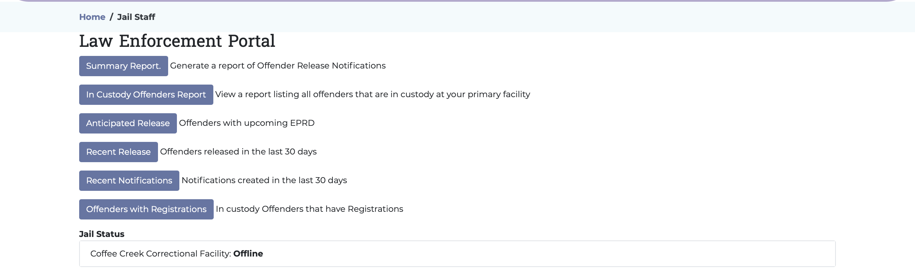
Search/View/Updated IIC data as jail management staff

Slide 13
Project Timeline

Slide 14
WHAT HAPPENS NEXT
DOC to provide further details on the victim portal URL.
Distribution of marketing materials.
Statewide demonstrations to increase awareness.
Solicit partner feedback for site improvements and future enhancements.
Addressing your questions and concerns.

Slide 15

Questions and Answers
What’s next
Communications & outreach
TRAINING & SUPPORT

